Slide 1
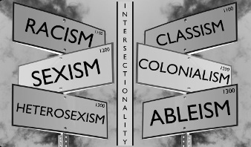
Using Intersectionality to Understand Post‐Secondary Pathways of
Marginalized Groups
Karen Robson (York University), Paul Anisef (York University), Rob Brown (TDSB).

Slide 2
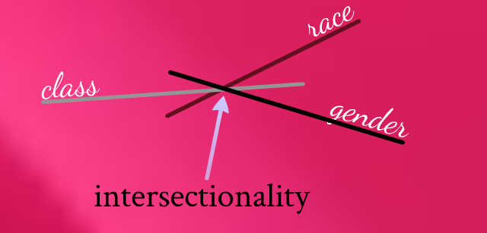
What is intersectionality?

Slide 3

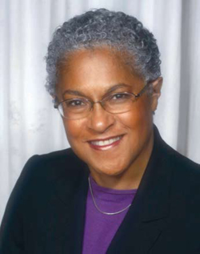
K. Crenshaw: When we don’t pay attention to the margins, when we don’t acknowledge the intersection, where the places of power overlap, we not only fail to see the women who fall between our movements, sometimes we pit our movements against each other. Women, Power & Peace conference, September , 2007.
P. Collins: By embracing a paradigm of race, class, and gender as interlocking systems of oppression, Black feminist thought reconceptualizes the social relations of domination and resistance.
Black Feminist Thought: Knowledge, Consciousness, and the Politics of Empowerment, 1990.

Slide 4
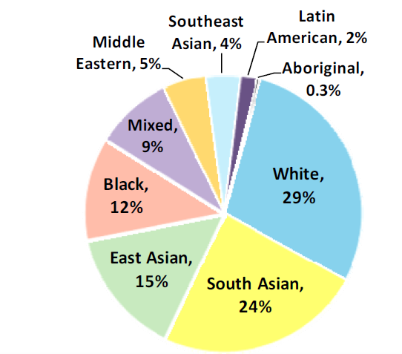
Situating the analysis
Toronto is one of the most ethnically diverse cities in the world

Slide 5
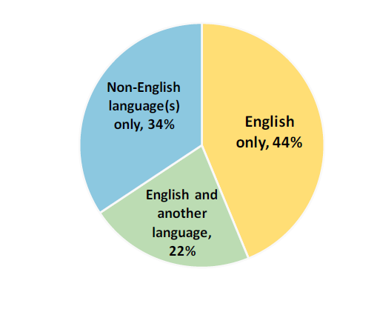
Home language

Slide 6
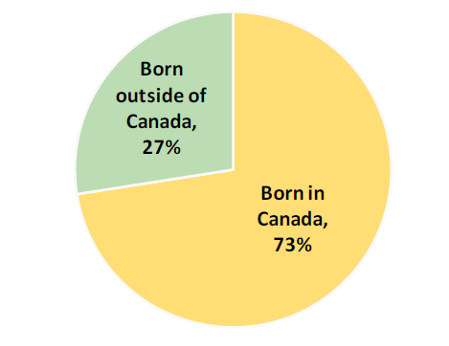
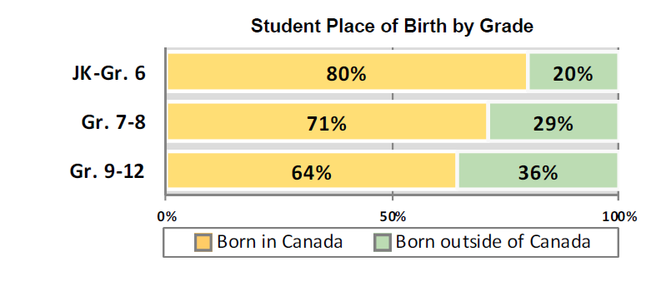
Place of birth

Slide 7
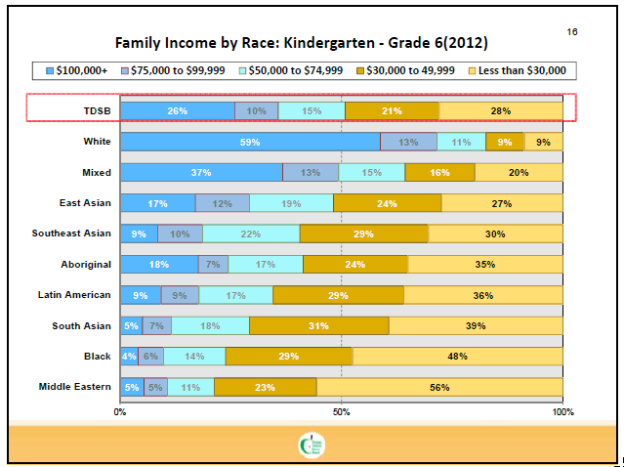

Slide 8
Data from Toronto, Canada
Constructed from various sources:
  Survey of all Toronto secondary school students (2006)
  2006 Toronto student Census
  Administrative data from the school board
  College and university application centers
  Neighbourhood census information (2001)
  N=approximately 17,000

Slide 9
Questions of interest
How do race, immigration status, and gender interact to impact PSE choices?
And once we know these things…then what?

Slide 10

Interactions
(technical stuff)
Many interesting findings in the social sciences involve ‘‘interaction” effects, also known as ‘‘moderator” or ‘‘synergistic” effects
Two variables have an interaction effect on a dependent variable if the relationship of either independent variable with the dependent variable changes across values of the other independent variable.

Slide 11
Race/region of origin in our sample

Slide 12
Low neighbourhood income by race/region
As percentage of total sample
Within-race proportions
 | % in poor lowest quartile of income | % of overall sample
Black | 19% | 10%
E Asian | 20% | 23%
Latin | 3% | 2%
MiddleE | 7% | 5%
S Asian | 29% | 21%
SE Asian | 4% | 3%
White | 18% | 37%

Slide 13
Generation status and race/region
Race and generation cannot be separated from each other

Slide 14
Generation status and low neighbourhood income
First generation
33%
Second Generation
22%
Third Generation
10%
Generation and income cannot be separated from each other.

Slide 15
Generation status and race/region by lowest neighbourhood quartile

Slide 16
PSE Confirmations by Race

Slide 17
Confirmations by Race
Race and PSE pathways differ according to type of institution

Slide 18
Sex by PSE confirmations

Slide 19
Confirmations by Race and Gender
Gender is also a major determinant of type of PSE transition

Slide 20
Multinomial logistic regression (South Asian Students)

Slide 21
Multinomial logistic regression (Black students)

Slide 22
Multinomial logistic regression (white students)

Slide 23
Average Probabilities of Confirming College - Interaction of Black*SEN*Applied

Slide 24
Conclusions (?)
PSE trajectories affected by range of characteristics
Mustn’t forget the “gappers”
How can policy be targeted?

Slide 25



Thank you!
klrobson@yorku.ca
Ontario Ministry of Training, Colleges and Universities financially supports this research

Slide 26
References
Choo, Hae Yeon, and Myra Marx Ferree. "Practicing Intersectionality in Sociological Research: A Critical Analysis of Inclusions, Interactions, and Institutions in the Study of Inequalities*." Sociological Theory 28.2 (2010): 129-149.
Dubrow, Joshua Kjerulf. "How can we account for intersectionality in quantitative analysis of survey data? Empirical illustration for Central and Eastern Europe."ASK. Research&Methods 17 (2008): 85-100.
McCall, Leslie. "The complexity of intersectionality." Signs 30.3 (2005): 1771-1800.
Patricia Hill Collins, 1990. Black Feminist Thought: Knowledge, Consciousness, and the Politics of Empowerment (Boston: Unwin Hyman).

